Slide 1
Course Code: ICT-4103
Course Title: DigitaL ImaGe Processing lECTURE-03
Digital Image Processing: Whole world can be represented as data or information
“One picture is worth more than one thousand words”

Slide 2
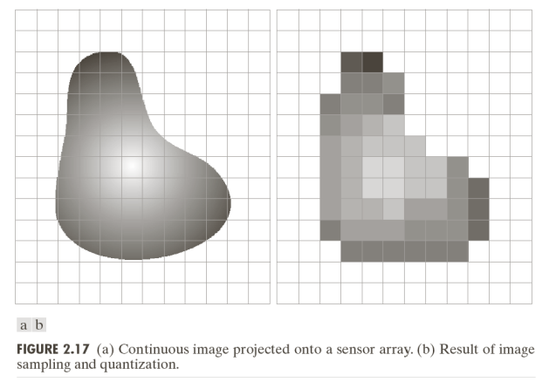
sAMPLING AND qUANTIZATION OF AN iMAGE

Slide 3
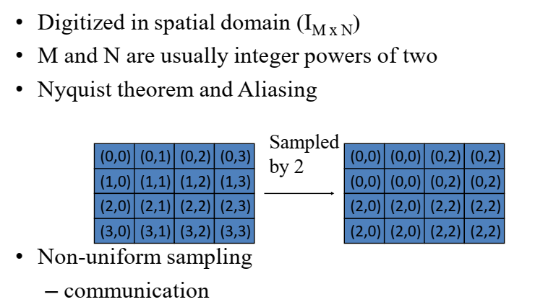
uNIFORM sAMPLING

Slide 4
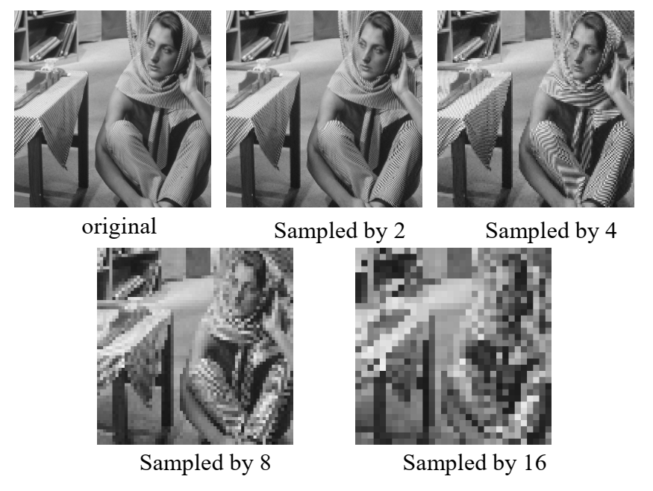
eXAMPLE OF SAMPLING IMAGES

Slide 5
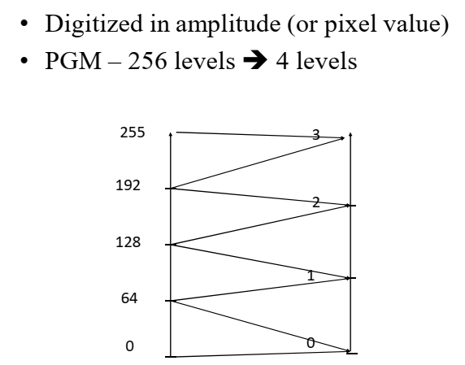
UNIFORM QUANTIZATION

Slide 6
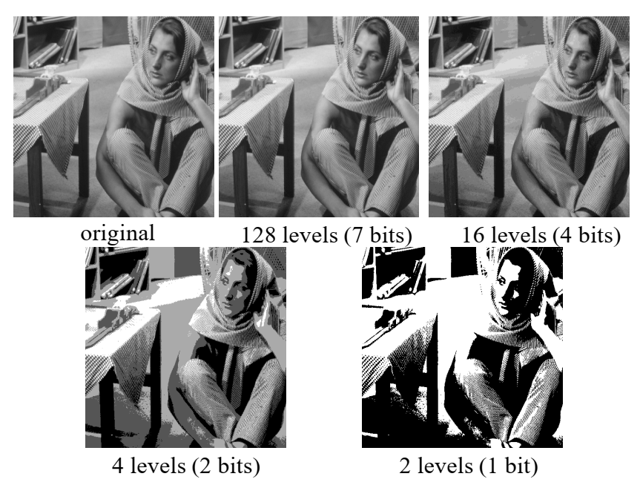
Uniform Quantization

Slide 7
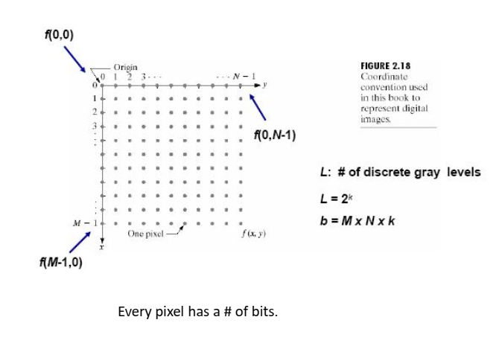
rEPRESENTATION OF DIGITAL IMAGES

Slide 8
DIGITAL IMAGE REPRESENTATION OF COORDINATE CONVENTION
The result of sampling and quantization is a matrix of real numbers
There are two principle ways to represent a digital image:
Assume that an image f(x,y) is sampled so that the resulting image has M rows and N columns. We say that the image is of size M x N. The values of the coordinates (x,y) are discrete quantities. For clarity, we use integer values for these discrete coordinates.
Digitizing the co-ordinate value is called sampling
Digitizing the amplitude value is called quantization

Slide 9
Digital Image Representation Coordinate Conventions
In many image processing books, the image origin is defined to be at (x,y) = (0,0). The next coordinate values along the first row of the image are (x,y) = (0,1). It is important to keep in mind that the notation (0,1) is used to signify the second sample along the first row. It does not mean that these are the actual values of physical coordinates. Note that x ranges from 0 to M-1, and y ranges from 0 to N-1.

Slide 10
Digital Image Representation Coordinate Conventions
– The coordinate convention used in toolbox to denote arrays is different from the preceding paragraph in two minor ways. Instead of using (x,y) the toolbox uses the notation (r,c) to indicate rows and columns. The origin of the coordinate system is at (r,c) =(1,1); thus, r ranges from 1 to M and c from 1 to N, in integer increments.

Slide 11
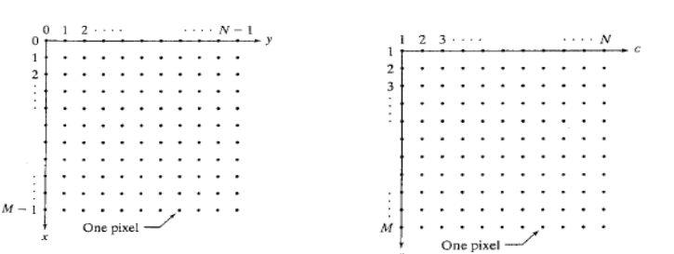
Digital Image Representation Coordinate Conventions

Slide 12
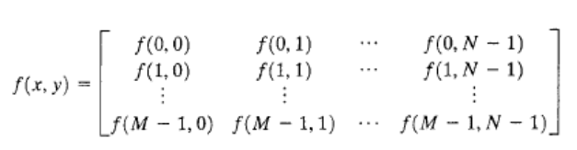
Digital Image Representation: Images as Matrices
The coordination system in figure (a) and the preceding discussion lead to the following representation for a digitized image function:

Slide 13
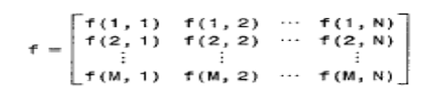
Digital Image Representation: Images as Matrices
The right side of the equation is a digital image by definition. Each element of this array is called an image element, picture element, pixel or pel.
A digital image can be represented naturally as a MATLAB matrix:
Where f(1,1) = f(0,0). Clearly, the two representations are identical, except for the shift in origin.

Slide 14
Pixels
Every pixel has how many of bits (k)
Q: Suppose a pixel has 1 bit, how many gray levels can it represent?
Answer: 2 intensity levels only, black and white.
Bit (0,1) → 0:black , 1: white
• Q: Suppose a pixel has 2 bit, how many gray levels can it represent?
Answer: 4 gray intensity levels
2Bit (00, 01, 10 ,11).

Slide 15
pixels
Now ..
if we want to represent 256 intensities of grayscale, how many bits do we need?
Answer: 8 bits → which represents: 28=256
so, the gray intensities ( L ) that the pixel can hold, is calculated according to according to
number of pixels it has (k). L= 2k

Slide 16
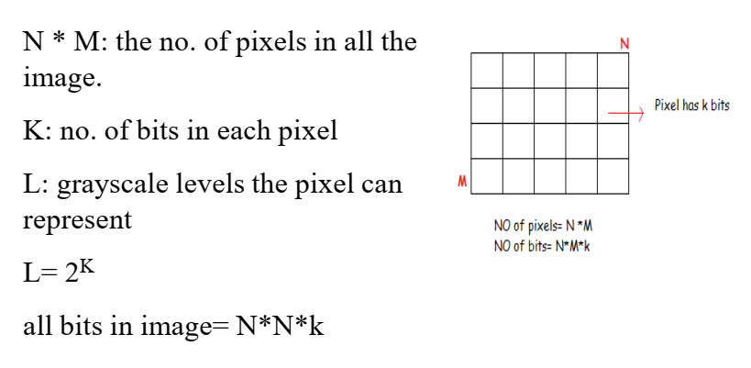
Number of storage of bits

Slide 17
Some Basic Relationship between pixels
Neighbouring Pixels:

